Slide 1
Climate Change and Twitter Influencers
Arnav Deshwal
Palakh Gupta
Junhong Xu
Rui Ying
Kelly Zhang

Slide 2
Outline
Twitter Data Scraping
Network Analysis
with Gephi
Influencers for Different Groups

Slide 3
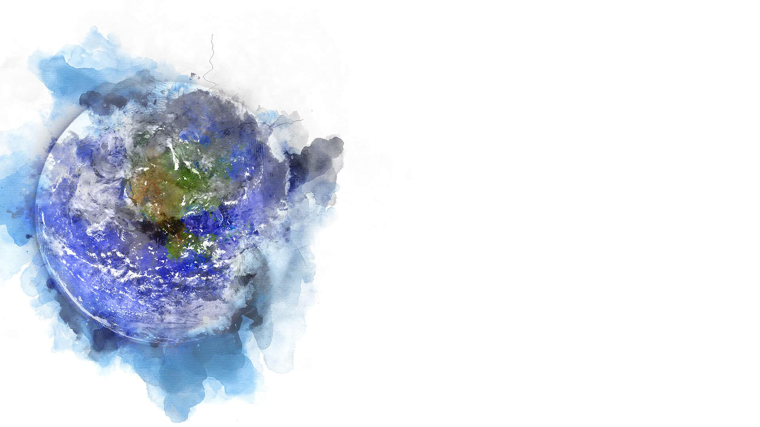
Climate Change Activist
#FridaysForFuture
5400 tweets in total
2-day span
Climate Change Deniers
#CliamteHoax
#ClimateHysteria
5400 tweets in total
10-day span

Slide 4
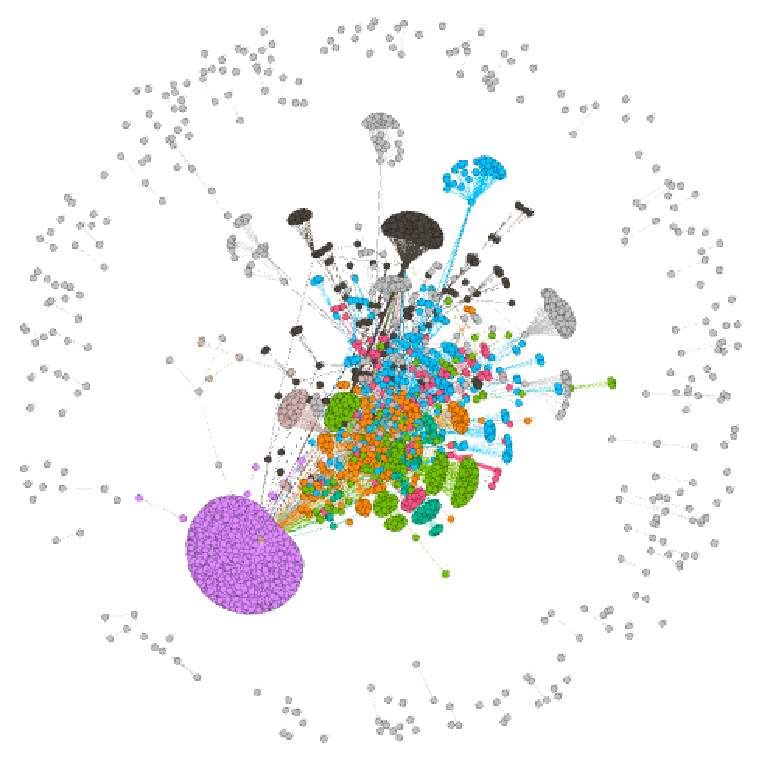
Supporters Community
Characteristics
One Major Community
Closely Connected
Communities
Teenage Activist
E.g. Greta
Youth
Business People
Notes:
Since we have the tag of the all the tweets, we decide to look separately into the supporters/denier of climate change and see.
From the graph we can see that there are a lot of communities, but all closely connected to each other.
There are few groups that stand out more, so we looked in to the center of this communities to find the influencers

Slide 5
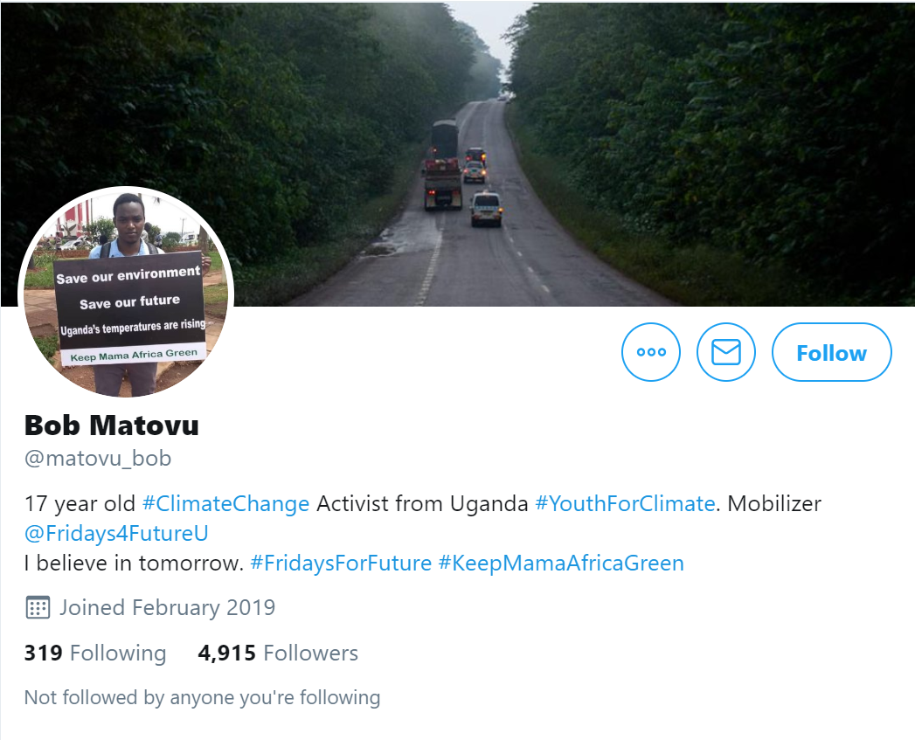
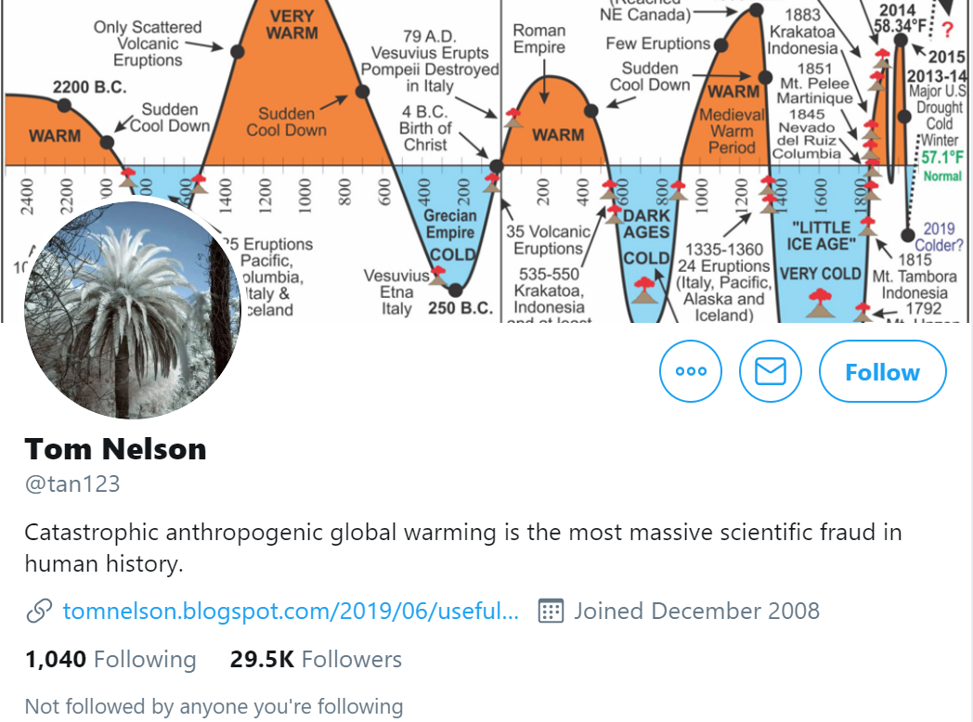
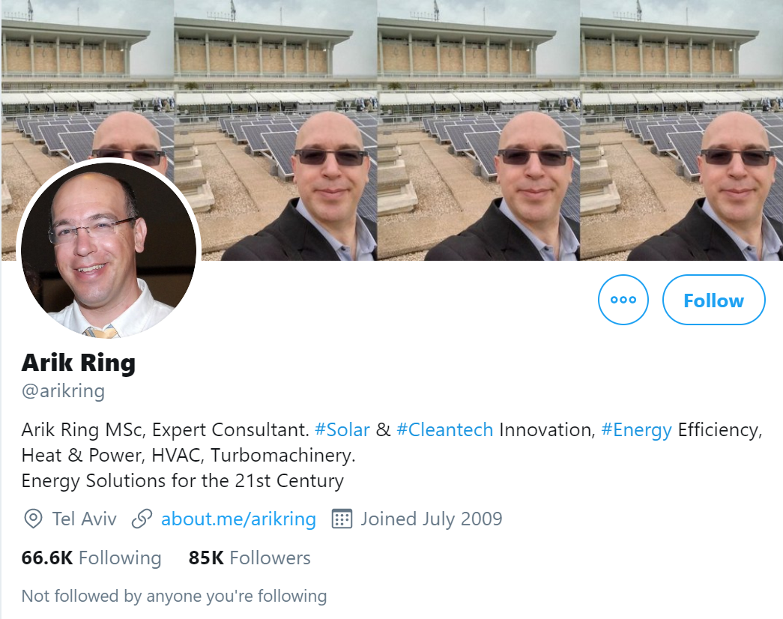
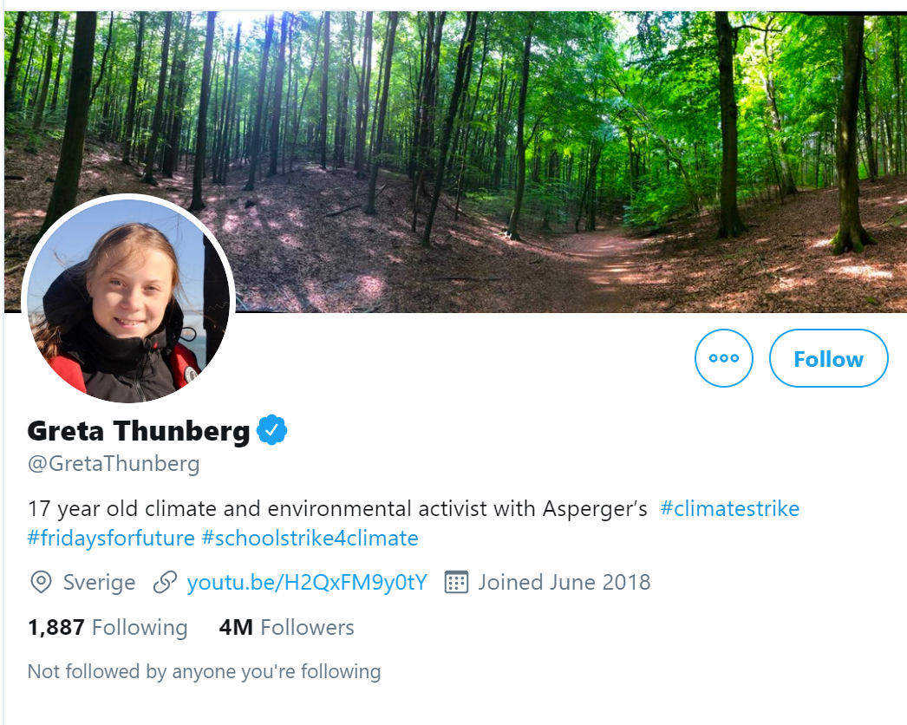
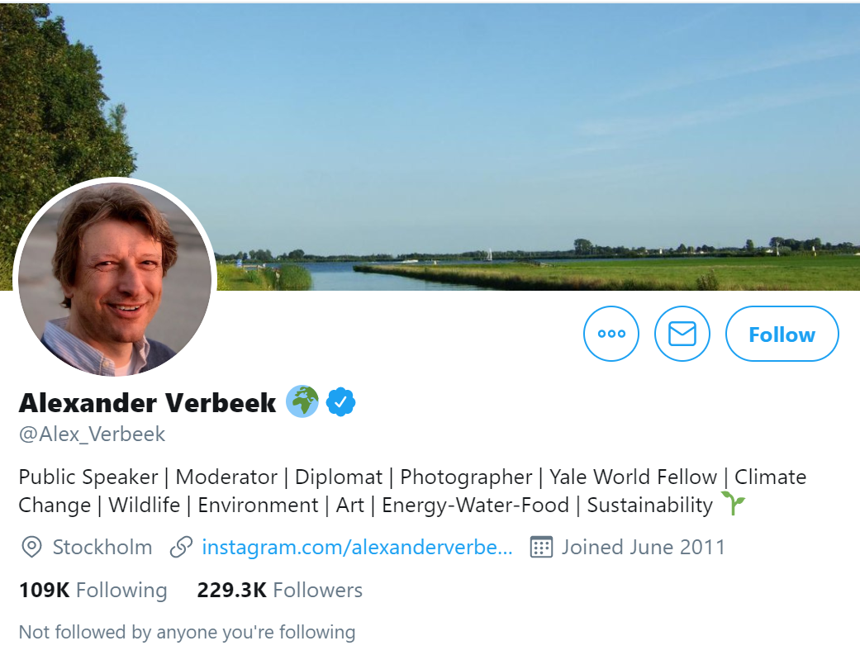
Notes:
The biggest community on the bottom left belongs to Greta, the teenager activist whose campaigning has gained international recognition.
In the middle we have a lot smaller communities that has a lot of young influencers like Bob, they could potentially be homophilies.
Alex is a environmentalist public speaker, Arik is owner of a solar power company. We can see that they are more of the business side of the supports.
Interestingly to note is that Tom Nelson is actually a climate change denier, but he frequently uses positive hashtags to interact with the supporters

Slide 6
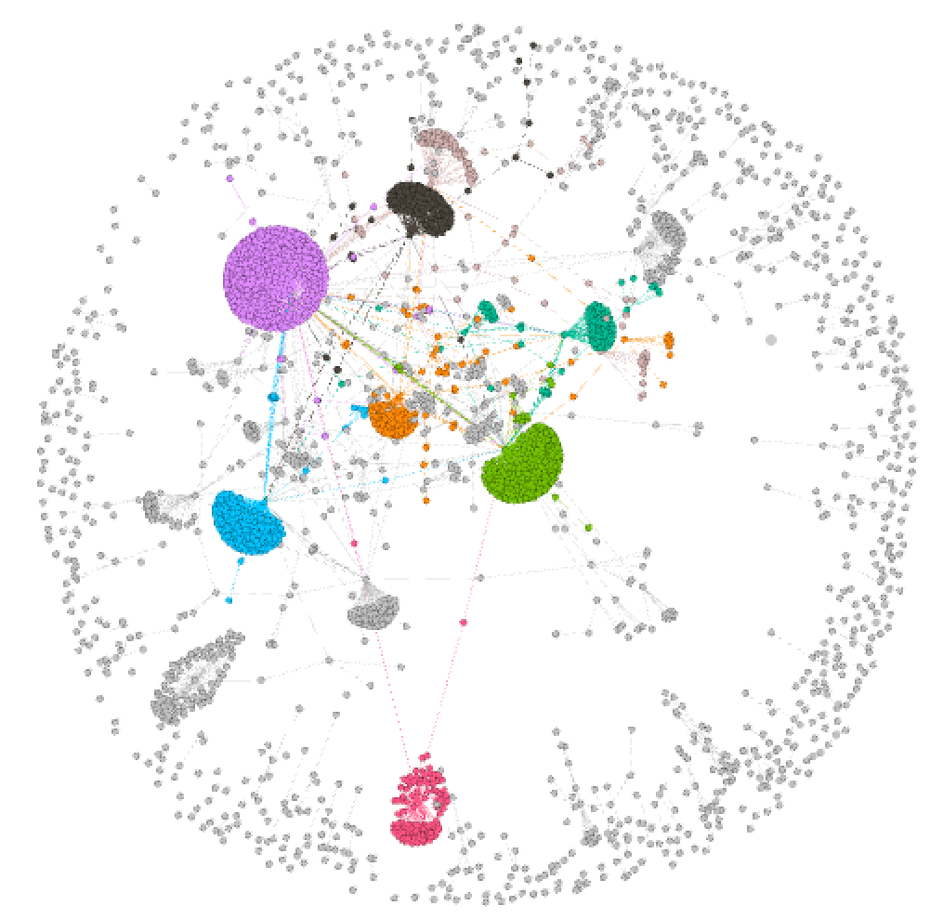
Deniers Community
Characteristics
Seven Communities
Dispersed
Communities(By Countries)
U.S.
Australia
UK
Brasil
Notes:
7 big communities with purple one as the biggest, dispersed and independent.
Especially, if we look at the bottom cluster, the pink one, we can see this cluster doesn’t have much interaction with the rest of clusters. It is just connected by a few persons.
While top part of the deniers communities have more interactions, retweeting happening, but not as strong as the ones showed by the supporters communities

Slide 7
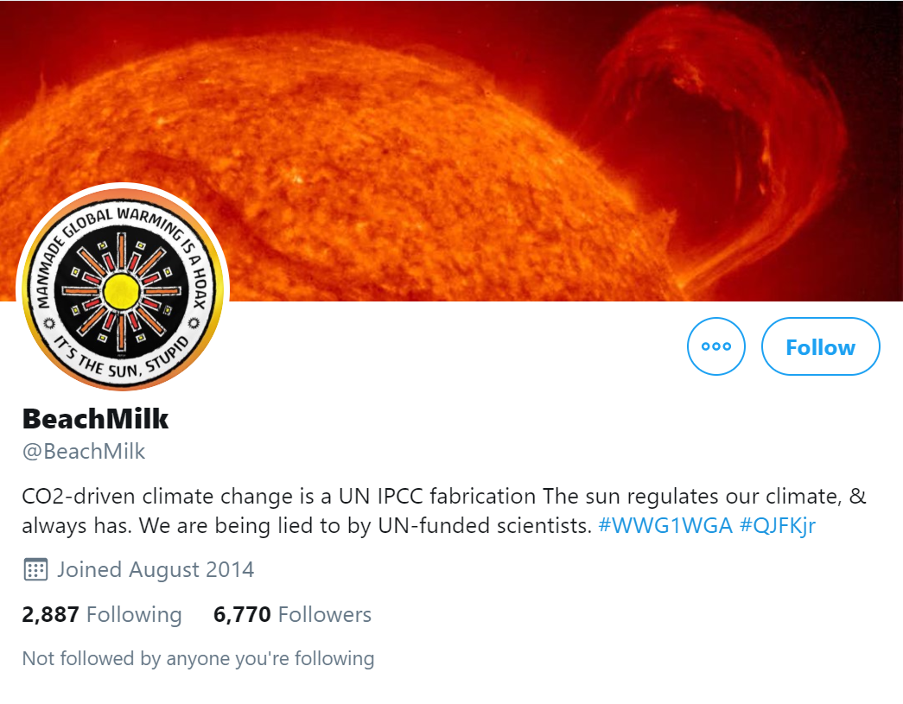
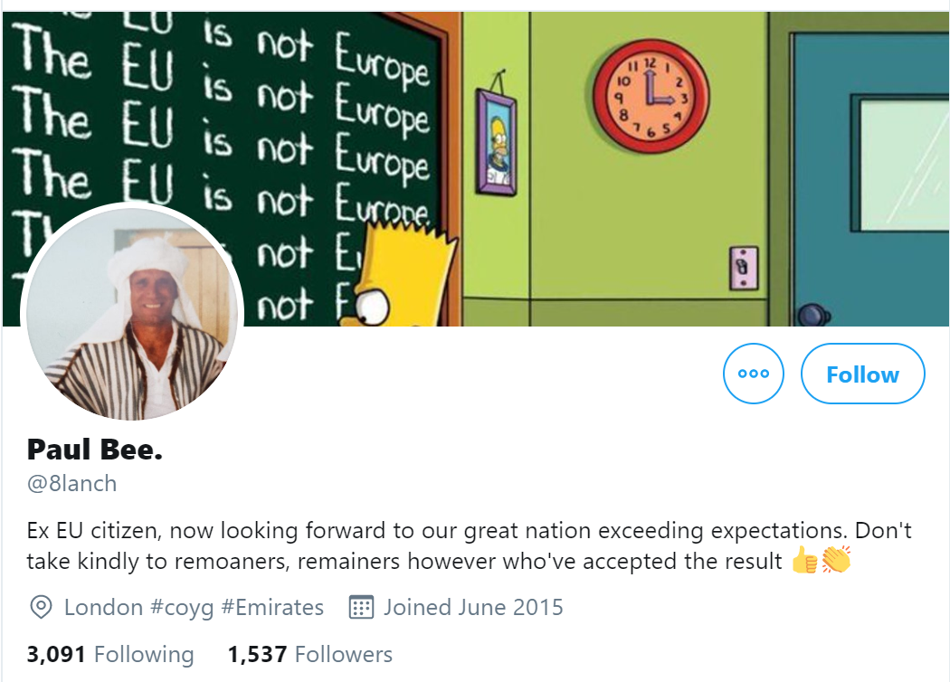
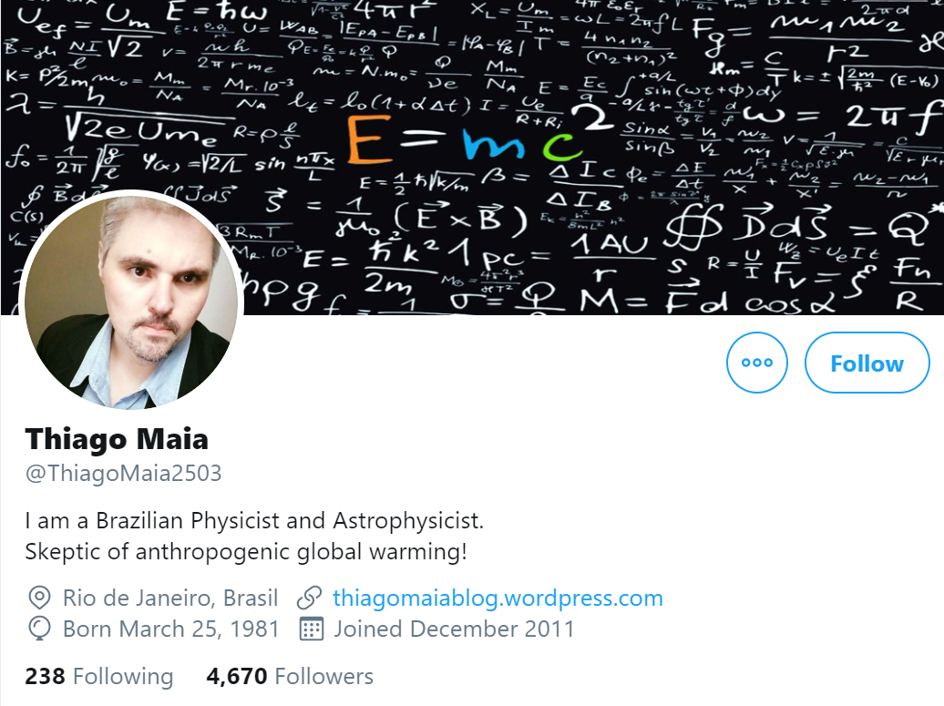
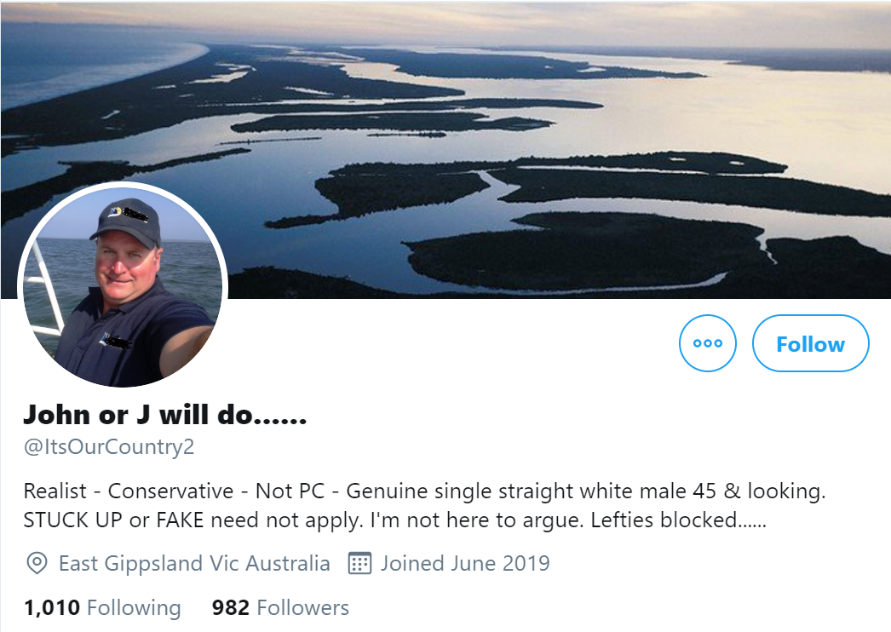
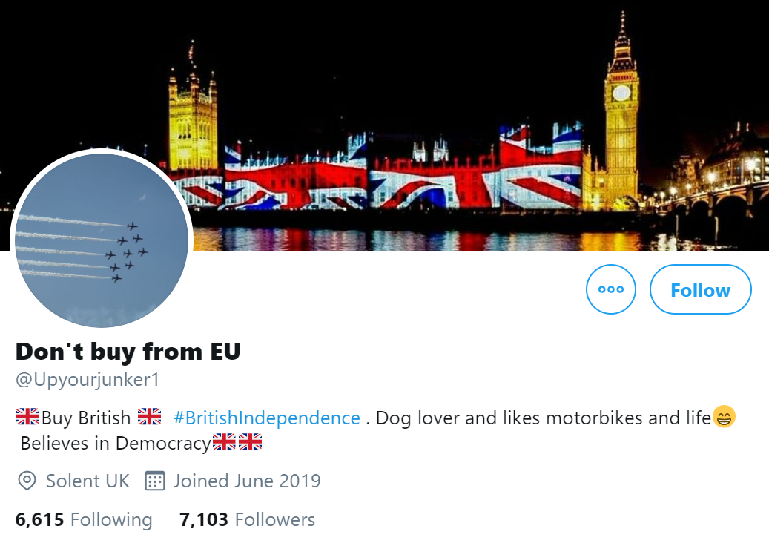
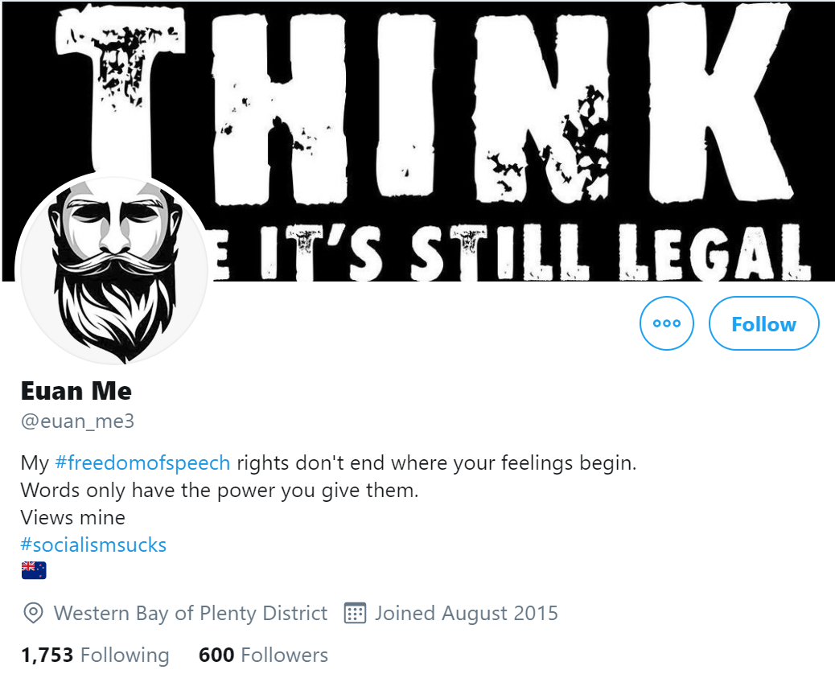
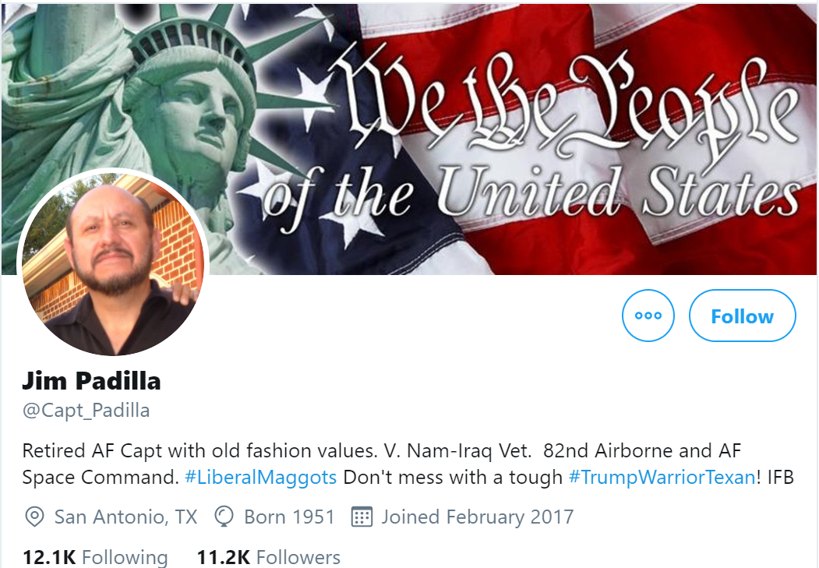
Notes:
For each community, we were able to identify the influencer and looked into their twitter accounts.
Here are a few things we found interesting.
For example, Beachmilk, he is a person who strongly believes in that sun places a role in regulating the climate, instead of carbon dioxide
Left bottom one, Don’t buy from EU, from his name, we can clear see his political affiliation.
On the other side, we were able to see the influencers are very international, we have people from UK, Brasil, Australia, US.
International
clusterclimatehoax
climatehysetria

Slide 8
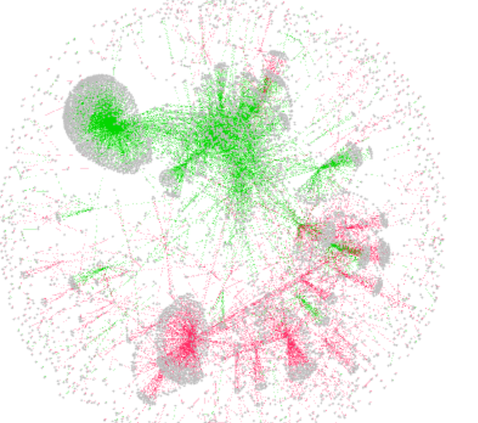
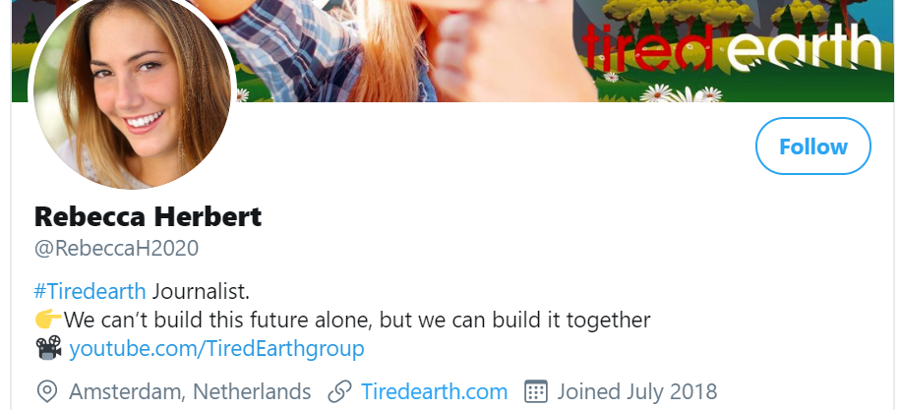
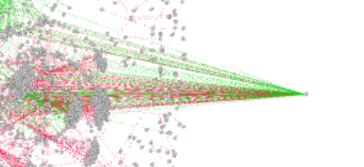
Influencers Network

Slide 9
Summary
Supporters
Homophily
Influencers
Business Focused
Shrewd Deniers
Notes:
Homophily - Greta Thunberg
Influencers - Bob Matovu
Business Focused - Alex Verbeek and Alex Ring
Shrewd Deniers - Tom Nelson

Slide 10
Deniers
Spread across the globe
Limited support to each other
Nationalist Attributes
Politically Inclined
Popular individuals such as journalists are targeted by both communities
Notes:
Deniers are spread across the globe and show a limited network to each other
They believe in esoteric ideologies such as Beachmilk with his sun not co2 and don’t buy from EU (brexit)
One interesting thing is that when you look at the supporters they don’t categorise themselves from their country whereas the deniers actually mention it in their bio which made us believe deniers have strong nationalist attributes and are more politically inclined

Slide 11
Thank You!

